Slide 1
Introduction of gogolib4java
Xiong Hongyu
July 20, 2011

Slide 2
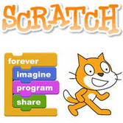





Software Libraries of GoGo Board Except GoGo Monitor
Microworlds
Netlogo
Scratch
C#
Flash
c/c++ visual basic

Slide 3
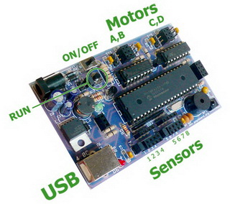

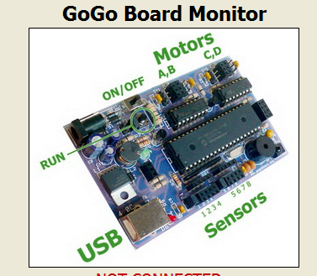
Java API for GoGo Board

Slide 4
gogolib4java
http://code.google.com/p/gogolib4java/
Java API to work with GoGo Board.
Currently it can only communicate with GoGo Server embedded in GoGo Monitor through socket.
It CANNOT directly control the local connected GoGo Board

Slide 5
Java API for GoGo Board

Slide 6
Beep.java
import kr.ac.scnu.cn.gogolib.GoGoClient;
public class Beep
{
public static void main(String[] argv)throws Exception{
// connect to local running GoGo Monitor
GoGoClient ggClient = new GoGoClient("localhost", 9873);
ggClient.beep();
System.out.println(ggClient.receive());
ggClient.close();
}
}

Slide 7
LedController.java
import kr.ac.scnu.cn.gogolib.GoGoClient;
public class LedController
{
public static void main(String[] argv)throws Exception{
// connect to local running GoGo Monitor
GoGoClient ggClient = new GoGoClient("localhost", 9873);
//the argument should be 'on' or 'off'
if( argv[0].equalsIgnoreCase("on"))
ggClient.ledOn();
if( argv[0].equalsIgnoreCase("off"))
ggClient.ledOff();
System.out.println(ggClient.receive());
ggClient.close();
}
}

